Slide 1

Argaman WWTP Case Study
ISRAEL
About us
DHV MED is an Engineering and Environmental Consulting company with a workforce of 50 engineers and consultants.
The company specializes in environmental consulting, environmental regulation, water supply and sewage, air quality, soil, and solid waste, as well as planning and management of engineering projects.
The major expertise of the company is design of waste water treatment plants (WWTP)
Hagai Kotzer

Slide 2




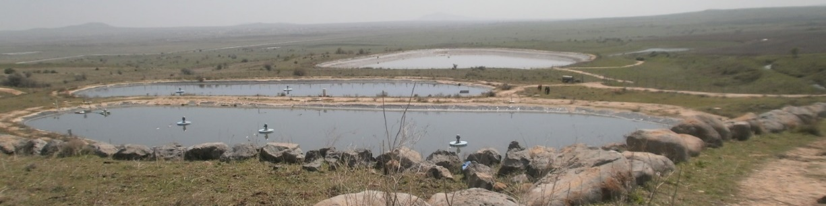
Background Argaman WWTP
Rural project treating of 6,000m^3 per day.
Location
The Golan
heights
Temperature
in the summer
~ 35c
Temperature
in the winter
~-5c
Effluent Quality
BOD- 100mg/l
TSS – 100mg/l

Slide 3
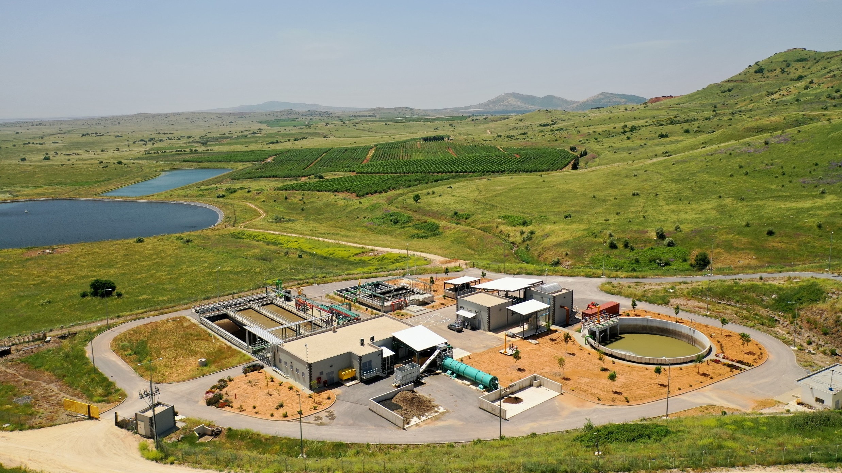
Target values | Value | Unites | Parameter
5 | 10 | mg/l | BOD
12 | 100 | mg/l | COD
2.5 | 10 | mg/l | TSS
14.6 | 50 | mg/l | N (Nitrogen)
3,8 | 10 | mg/l | P (Phosphorus)
1.5 | 2 | mg/l | Fecal Coli
The Challenge:
Building a new plant with a very high standards due the fact that there are new standards for the effluents
Contact: Hagai@DHVmed.com

